Slide 1
EGT309 Project Slides
By: Sai Keerthan (Leader), Richie, Jun Ming, Xiu Wen

Slide 2
Agenda
Project Introduction
Exploratory Data Analysis
01
02
Project objective; processes & tools; timeline
Data cleaning; Table merging; Initial data insights
Machine Learning Pipeline
03
04
Containerisation
Pipeline architecture; Model selection, Training and evaluation metrics
Application containerisation

Slide 3
01
Project Introduction
Xiu Wen

Slide 4
About The Project
Our project objective is to help Olist identify potential repeat buyers, enabling Olist to build their customer base and increase future sales revenue.

Slide 5
Project Strategy Processes
01
02
Data Cleaning (EDA)
Visualisation(EDA)
03
04
Model Training
Build the Pipeline
Utilise the cleaned master dataset and chart up visualisations using PowerBI & Python for insights.
Clean the dataset and then use business and python logic to create master dataset.
Train Various different ML Models to predict the repeat buyers and fuse them to create a stacked Model.
Utilise Docker & Kedro to build the Machine Learning Pipeline.

Slide 6
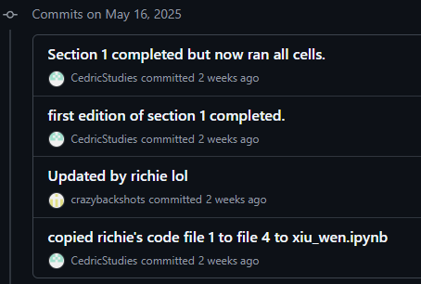



Tools Used
GitHub
Version Control
Created 4 branches for 4 team members
>37 commits (w.e.f. 2nd June)
Docker
Containerised application
Kedro
Machine Learning Pipeline

Slide 7
Project Timeline (By Week)
All: Set timeline and project roles
Xiu Wen: data cleaning
Richie: visualisation
Sai & Jun Ming: shared work of model training, training two models each
Jun Ming: Pipeline
Sai: Containerised application
Planning
Data Cleaning
ML Model
Pipeline
04
05
06
07

Slide 8
02
Exploratory Data Analysis
Data Cleaning and Table Merging: Xiu Wen
Visualisations: Richie

Slide 9
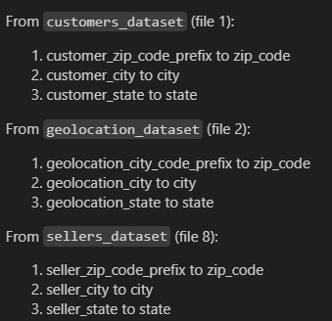
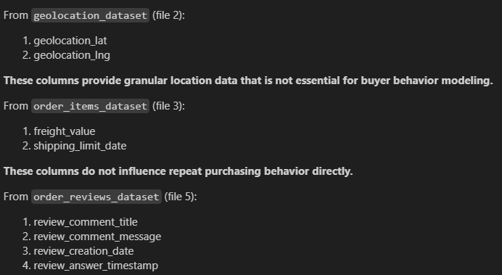
Data Cleaning
Dropped redundant columns
Renamed columns for uniformity

Slide 10
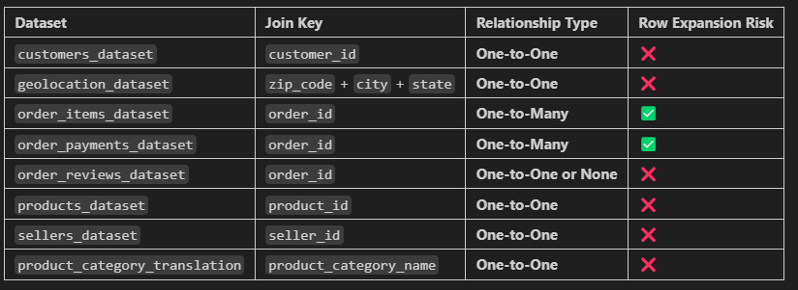
Table Merging
order_items_dataset: each order can contain multiple items.
order_payments_dataset: each order can contain multiple payments.
Row Expansion leads to double counting; misleading visuals; overfitting

Slide 11
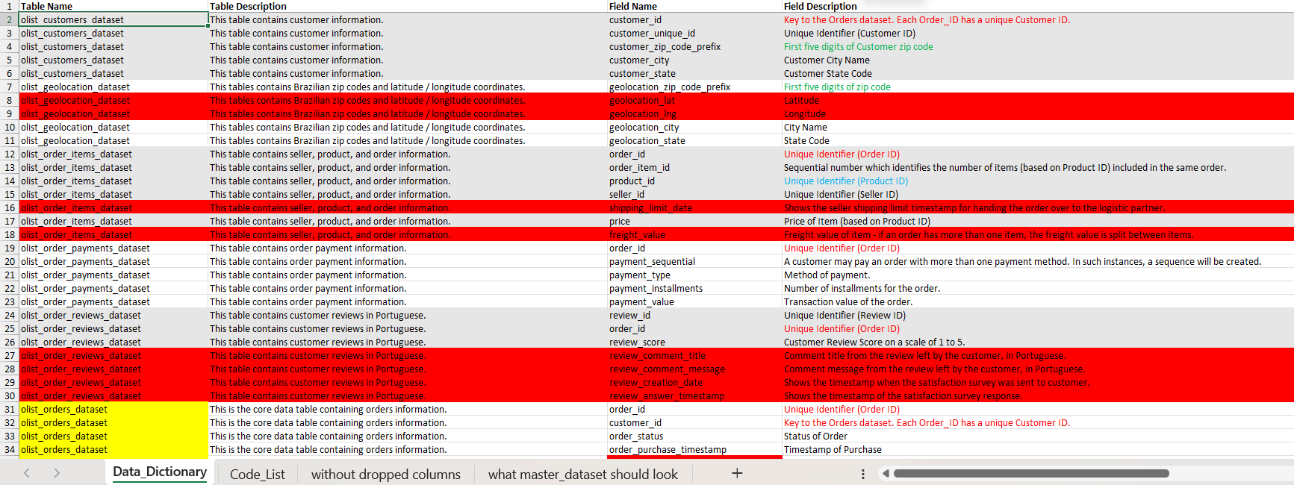
Dropped redundant files
First dataset to build master dataset
Identify columns to merge on

Slide 12
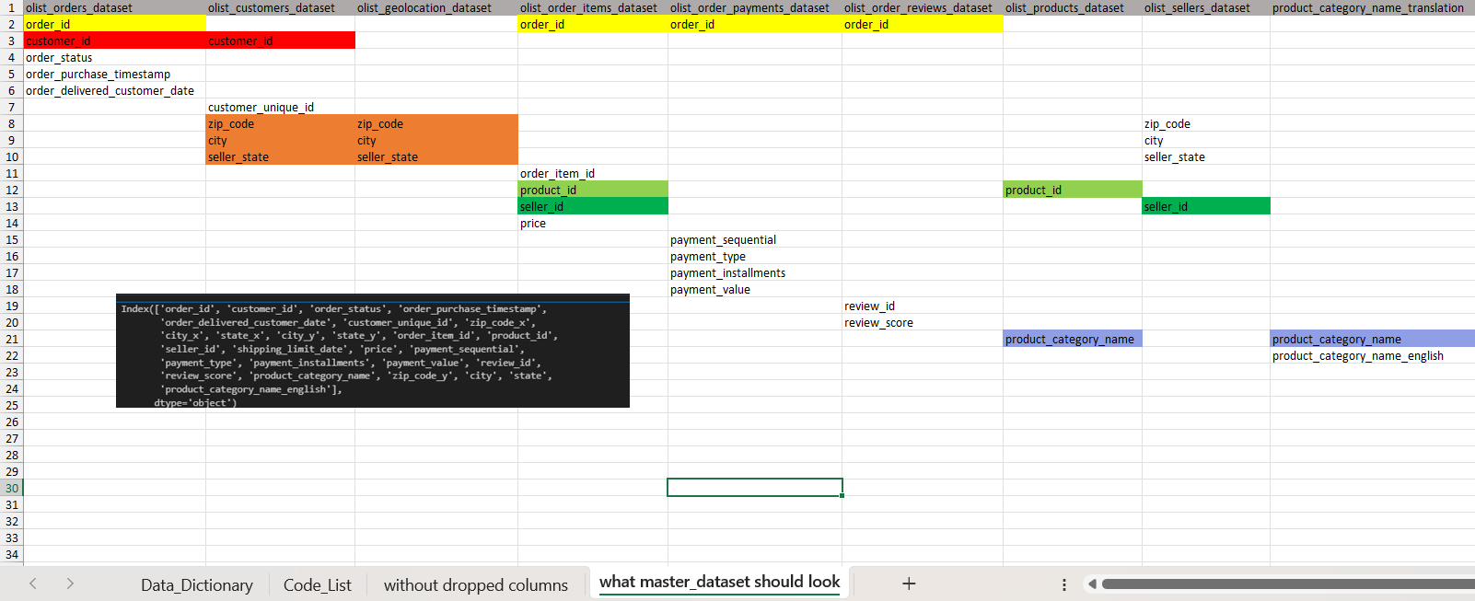
Column to merge on
Column to merge on

Slide 13
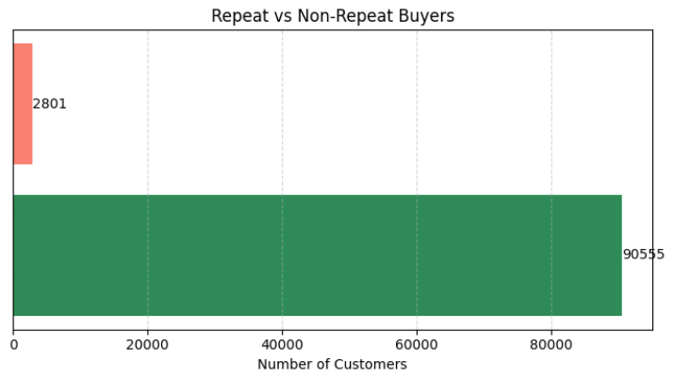
Visualizations (Repeat Customers)
About only 3% of our buyers are actually repeat buyers.

Slide 14
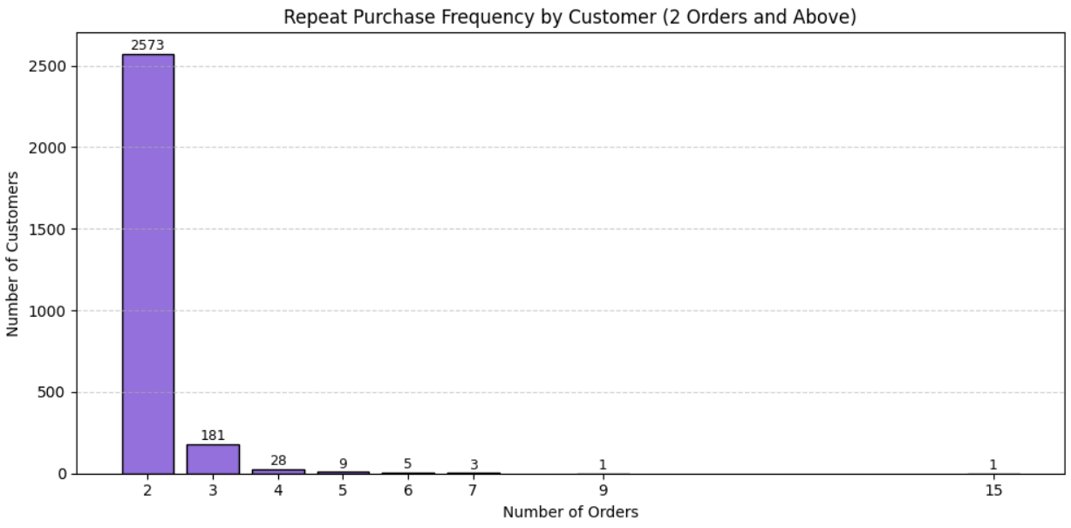

Slide 15
After seeing such few repeat buyers, we questioned ourselves…why and what affects this?

Slide 16
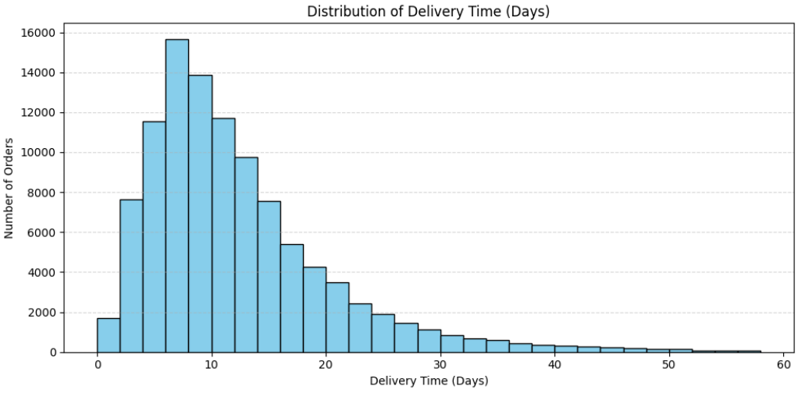
Delivery Time Analysis/Operational Analysis
Some of the orders are under 10 days of delivery time, however most of them tend to go over that, which I would consider long delivery time.

Slide 17
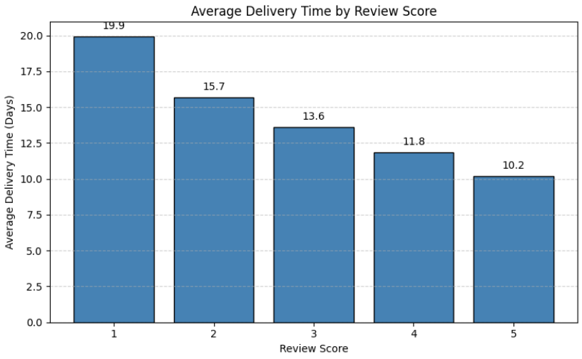
Delivery Time by Review Score
You can also see the correlation whereas most of our customers tend to give 5-star reviews when delivery time is around 10 days.
There is a huge 10 days gap between 1-star reviews and 5-star reviews.

Slide 18
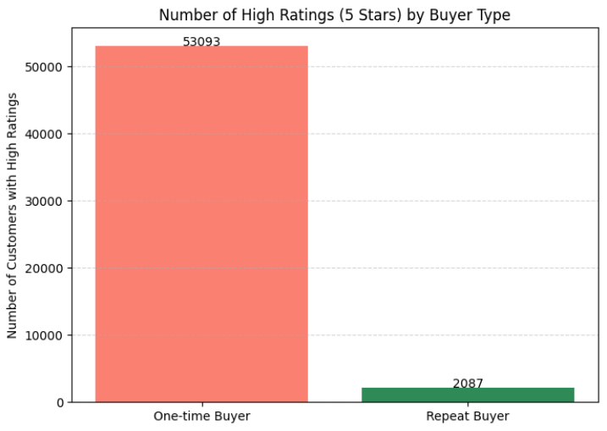
Satisfied Customers are more likely to return
74.75% of repeat buyers gave 5-star reviews, compared to only 59.02% of one-time buyers.
This suggests that repeat buyers tend to be more satisfied potentially due to faster delivery and better overall experience.

Slide 19
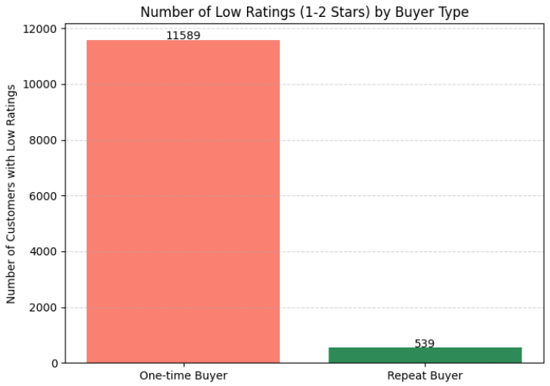
Repeat Buyers Give More Low Ratings Proportionally
Although more low ratings come from one-time buyers in total, Repeat buyers have a much higher percentage of Low ratings than that of one-time buyers, suggesting that maintaining consistent satisfaction over time is crucial.

Slide 20
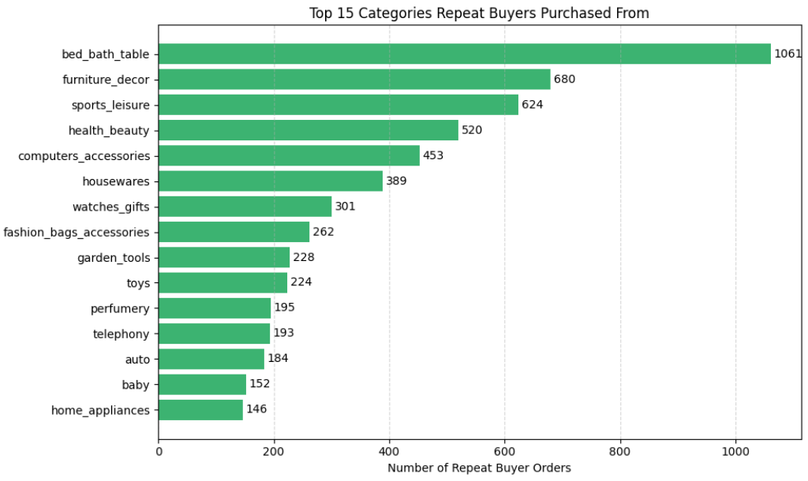
What do our repeat buyers actually spend their money on?
This shows that our loyal customers tend to spend their money on home and lifestyle-related categories like bed_bath_table, furniture_decor, housewares. This indicates that customers are more likely to return when purchasing home-related products.

Slide 21
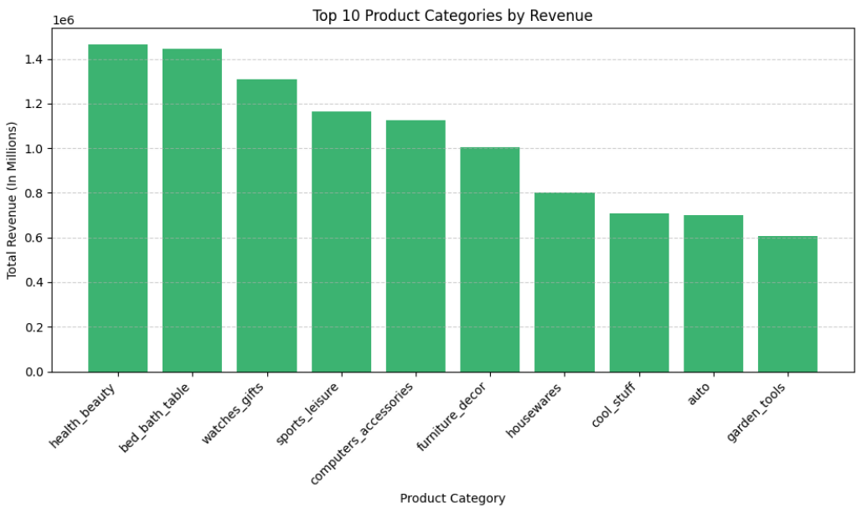
What do our repeat buyers actually spend their money on?
Which can be reflected on the top 10 product categories generating the highest revenue, showing that repeat buyers have an impact on the revenue generated.

Slide 22
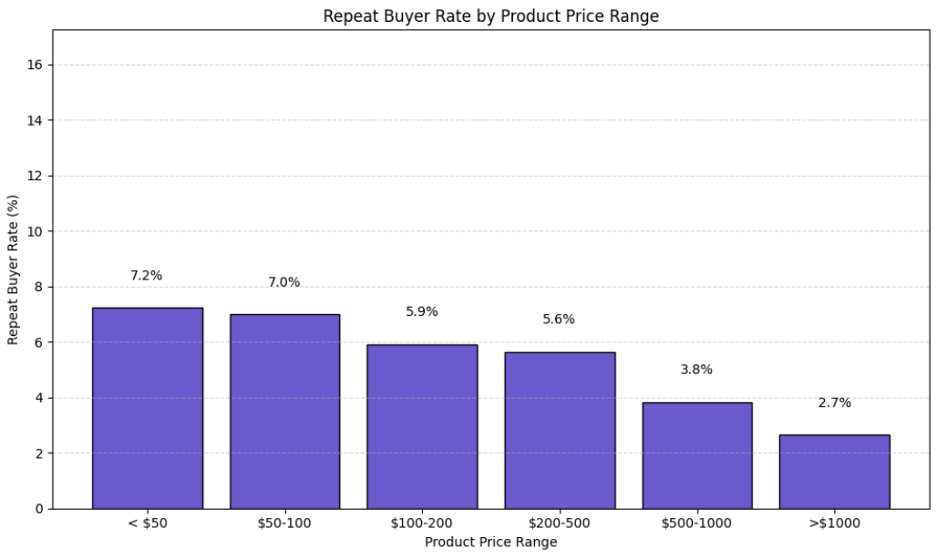
Do Buyers Repurchase More Frequently for Cheaper or Expensive Products?
As shown in the graph, you can see the steady decline of repeated buyers as the price range of the product increase.

Slide 23
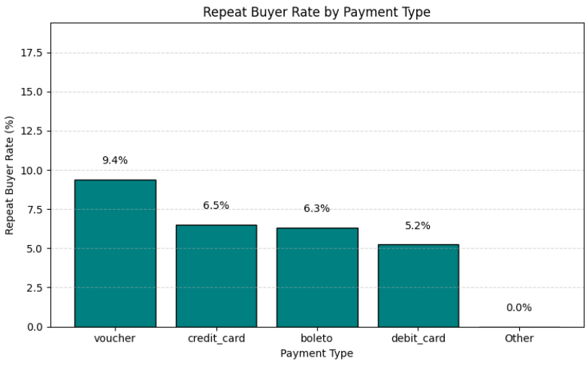
Do Payment Methods Influence Repeat Buyer Rates?
As shown in the graph, majority of repeat buyers prefer using vouchers as a payment type.
This indicates that discount-driven incentives can encourage repeat purchases.

Slide 24
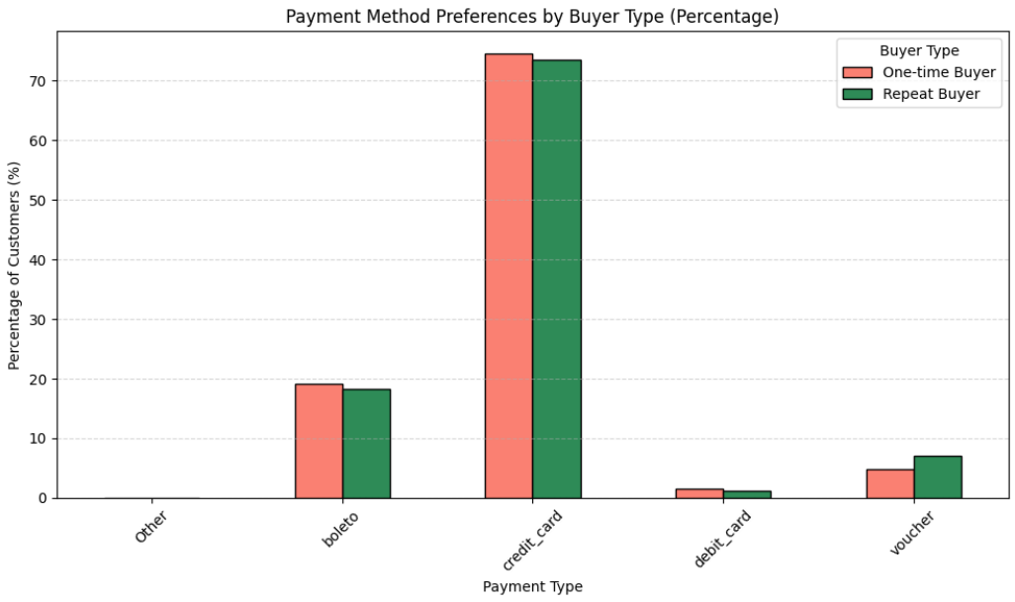
Do Payment Method Preferences Differ Between One-Time and Repeat Buyers?
Voucher usage stand out between repeat buyers and one-time buyers. Reinforcing its role in customer loyalty. This means that vouchers could potentially help convert one-time buyers to repeat buyers.

Slide 25
Insights Summary
To encourage more repeat purchases, Olist should focus on two key areas:
Delivery Consistency
Incentive Programs
Ensuring faster and more reliable delivery times.
Offering vouchers or discount incentives.
Provide added value through extended warranties or complementary accessories.
These benefits can help build trust and justify repeat purchases in higher price segments, potentially increasing the chances of re-purchases.
Notes:
Ensuring faster and more reliable delivery times can greatly improve customer satisfaction, as shorter delivery durations are linked to higher ratings and repeat purchases.
Offering vouchers or discount incentives has shown to be effective in encouraging customers to return.
Additionally, if Olist wants to increase repeat purchases for high-priced products, they should consider providing added value through extended warranties or complementary accessories.

Slide 26
03
Model Training
Jointly Trained by: Sai Keerthan & Leong Jun Ming

Slide 27
Models Trained
XGBoost
Random Forest
CatBoost
LightGBM
Sai
Jun Ming

Slide 28
Reasons behind Choice (Sai)
CatBoost
CatBoost handles categorical features natively, which is a huge advantage for your dataset that includes many categorical columns.
CatBoost does not require one-hot encoding or label encoding. It uses ordered boosting with target statistics to encode categories, reducing overfitting and improving accuracy.
CatBoost includes class weighting and handles imbalance better with fewer tuning tricks.
XGBoost
Trained XGBoost due to its reputation of being a powerful ensemble model, delivering top performance on structure/tabular data, which represents our Master Dataset.
Handles Non-Linearity well, able to capture complex patterns & Interactions between features Logistic Regression might not capture.
Supports for extensive, hyper-parameter tuning for better performance.

Slide 29
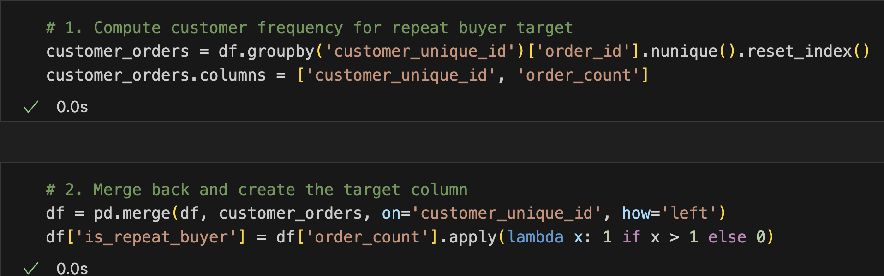
Creation Of Target Variable
Data Pre-Processing Steps
Since the Master Dataset did not contain the target variable column, it was up to us to create the target variable; where the name is “repeat_buyer”
Complex Logic was utilised before the Model Training, and the target column was assigned to the “y” tensor
First Block of code groups the dataset by unique customer(through customer_id), and counts how many unique orders(through order_id) each customer has made.
Second Block Of Code creates the target variable column through the logic: if order_count > 1, assign 1 in the repeat_buyer column for that customer, if not 0.

Slide 30
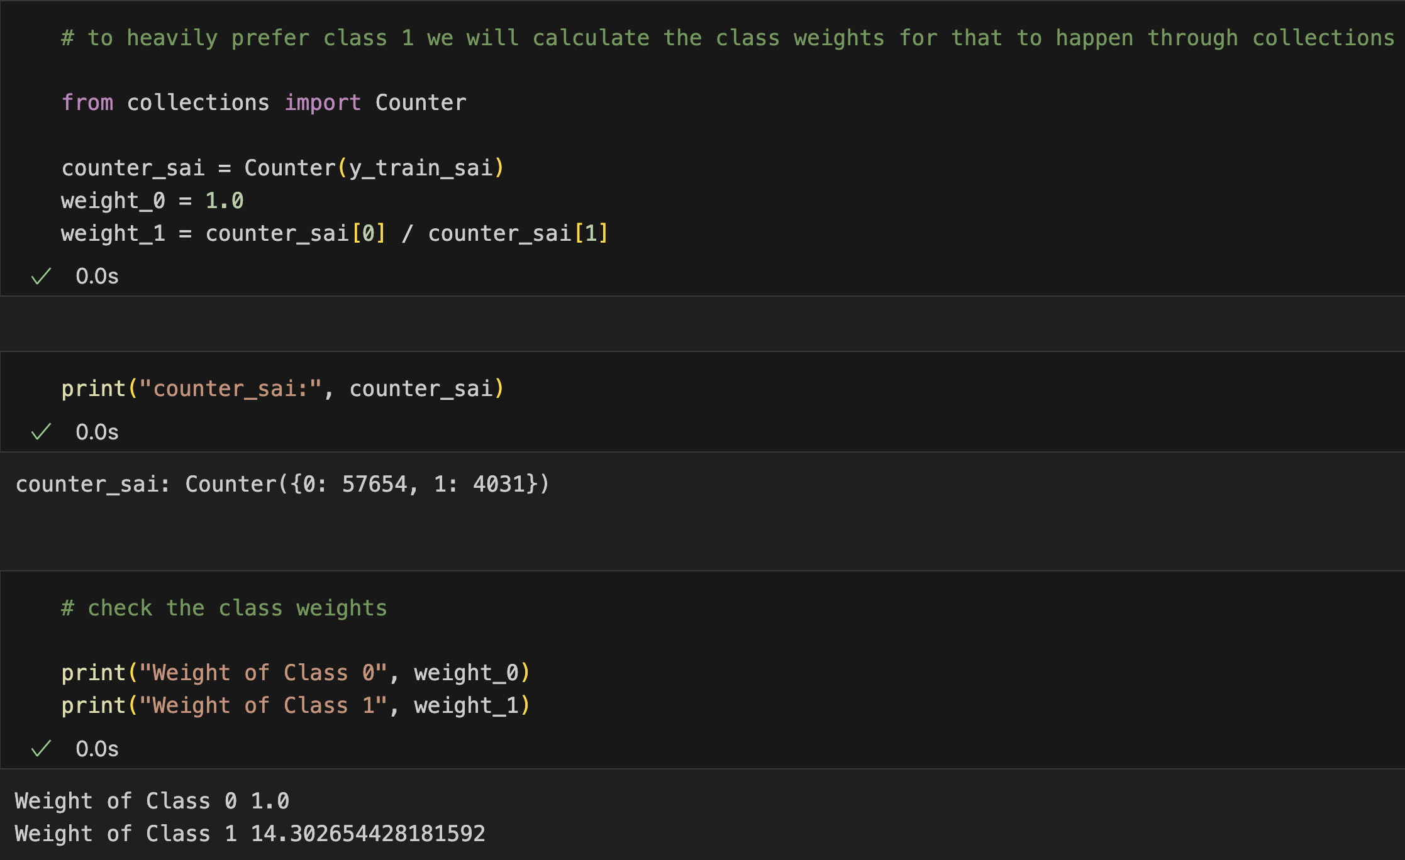
Data Pre-Processing
Class Distribution:
First block of code counts the number of samples for each class in the training set, prints the total count of samples for each class.
Second block of code sets the weights for both class, with class 0(non-repeat buyers)’s weights equal to 0, and the weights for class 1(repeat_buyers) is set through the mathematical logic: 57645/4031 = 14.302. Therefore, the weight for class 1 is 14.30
Necessary, as by increasing penalty for mistakes on Class 1, model is forced to pay more attention to the minority, making predictions more balanced and useful.

Slide 31
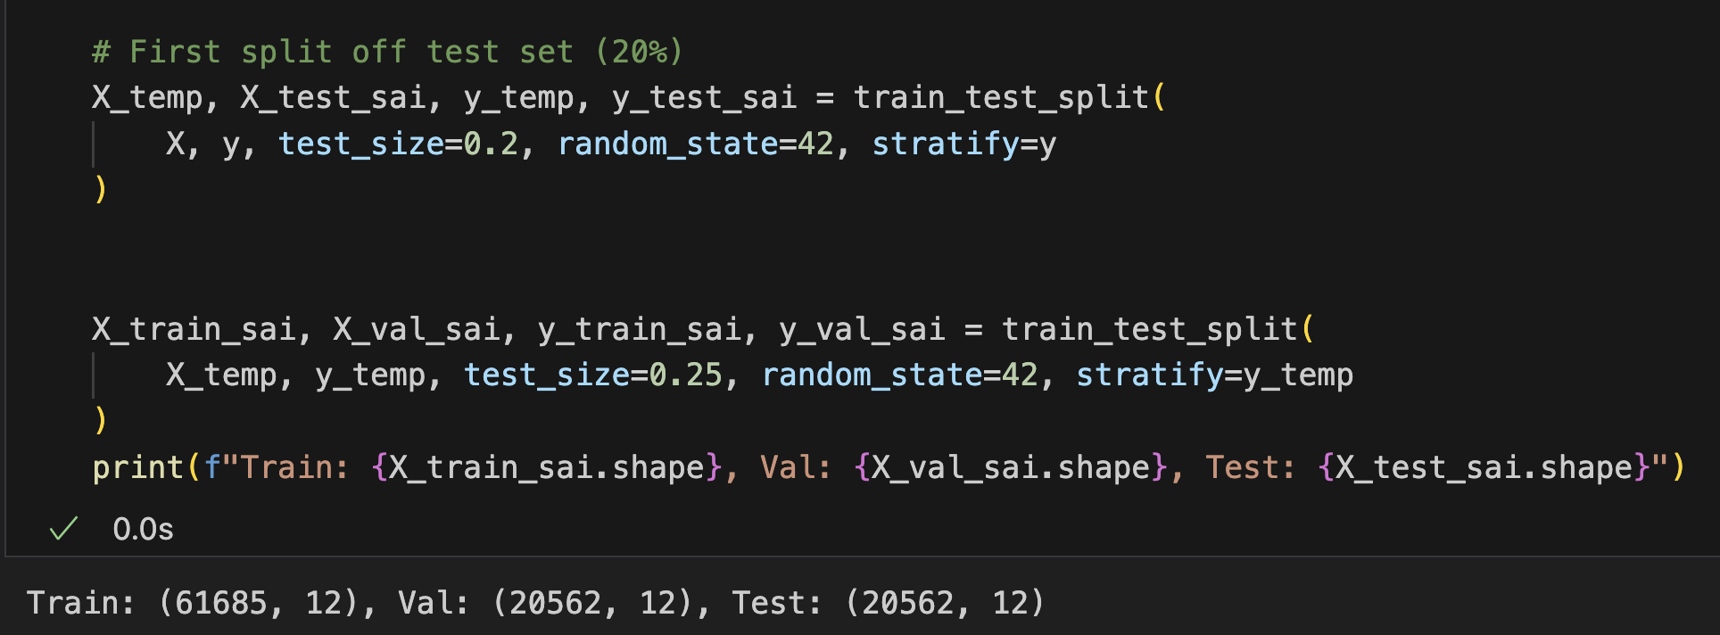
catboost (Sai)
Data Splitting: 80 – 15 - 5
Data is split into three sets: Train, Test & Validation, with the test set getting 20% of the total data.
The remaining data for train and validation is split further into 75% and 25% respectively.

Slide 32
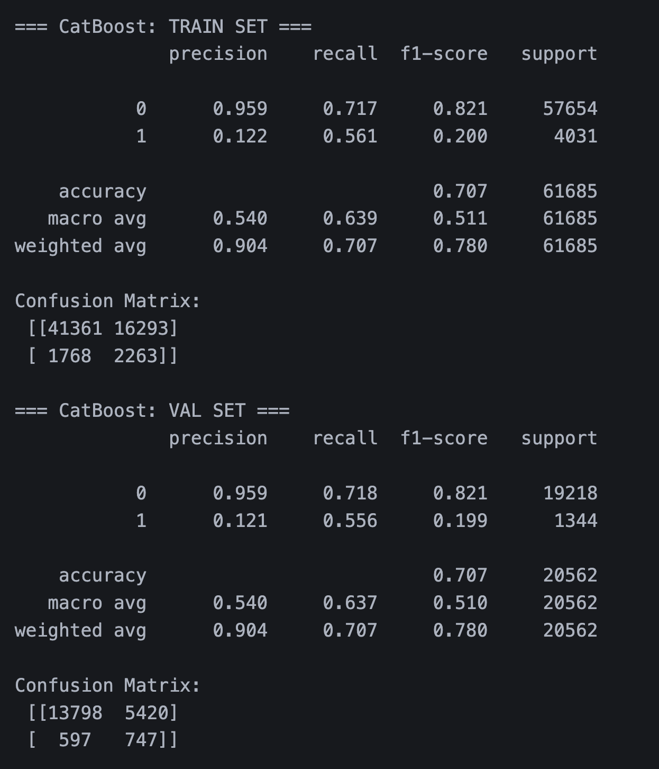
CatBoost(Sai)
CatBoost Metrics:
CatBoost was trained on similar Data PreProcessing steps as XGBoost, and it performed worser than XGBoost.
Despite it having a higher Recall than XGBoost, it failed to match the precision of the standalone XGBoost model for Class 1, scoring only a 12.2% in Precision
The CatBoost has shown similar performance to the train set as to the val set.

Slide 33
Reasons behind Choice (JunMing)
RandomForest
Captures non-linear relationships and interactions in high-dimensional e-commerce data.
Combining many decision trees makes Random Forest more robust to overfitting than single trees.
Handle class imbalances better with class weights, crucial for identifying repeat buyers amid a large volume of one-time buyers.
LightGBM
Uses histogram-based algorithms that speed up training time, making it efficient on large datasets.
Employs Gradient-based One Side Sampling (GOSS) to maintain accuracy by focusing on the data points with the highest gradients—helpful when dealing with imbalanced classes like repeat vs. non-repeat buyers.
Supports weighted loss functions and can scale positive class weights, making it effective for imbalanced datasets like repeat buyers vs one-time buyers.

Slide 34
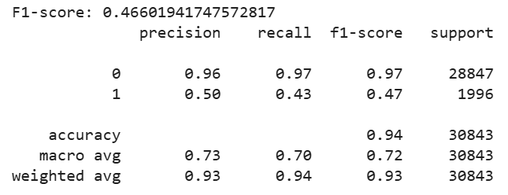
LightBGM (Jun Ming)
LightBGM Metrics:
The model performs well on the majority class (0), with high precision (0.96) and recall (0.97), indicating it correctly identifies most non-repeat buyers.
The model struggles with the minority class (1) (repeat buyers), with low recall (0.43) and F1-score (0.47), suggesting it misses many repeat buyers.
Despite the imbalance, the overall accuracy remains high (0.94), but macro-average metrics show lower performance due to the challenge of correctly classifying the minority class.

Slide 35
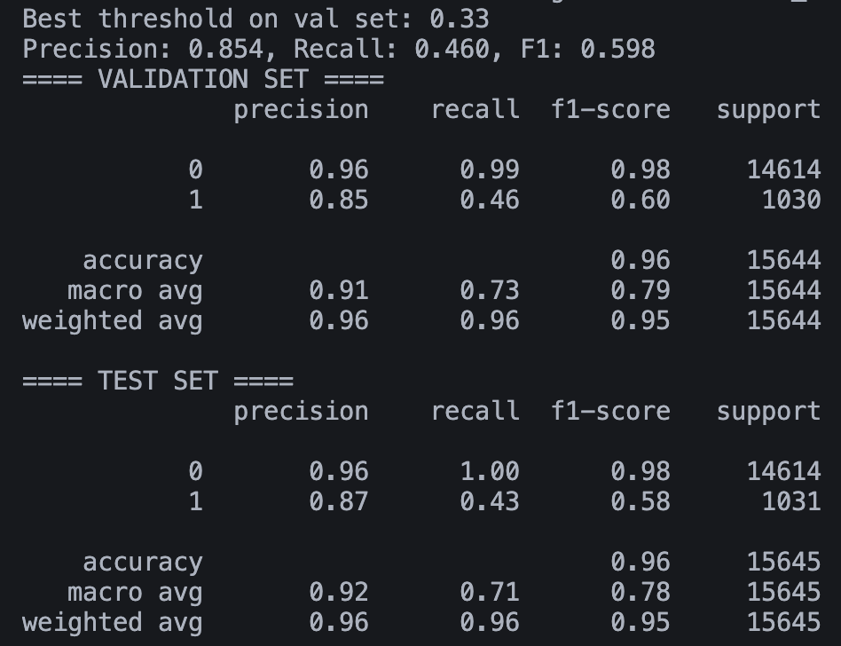
Final Stacked Model (RF, XGB, CatBoost & GBM):
Our Final Model is a stacked ensemble model, comprising of XGBoost, Random Forest, LightGBM & CatBoost Classifier. The main goal is to leverage the strength of the diverse learners.
LightGBM & RandomForest are known to capture non-linear relationships and interactions in the data, and they handle high-dimensional datasets efficiently which improves the overall model robustness.
XGBoost & CatBoost are known to handle imbalanced data well, through in-built class weighting.
Ensemble models allows to balance bias and variance across learners, which is crucial for our case scenario where the class is imbalanced.
As compared to the Classification Report from the individually trained models, Ensemble models help to gradually improve the macro average of the F1 score.
Notes:
We choose precision over recall, since the project objective is to target repeat buyers to launch marketing campaigns against them, it is better if the model predicts lesser of the class with more precision, allowing for the money spent on marketing to be more worth it as it is targeting true repeat buyers.

Slide 36
04
Machine Learning Pipeline
Jointly implemented by: Leong Jun Ming & Sai Keerthan

Slide 37
Kedro Pipeline Structure (JunMing)
## Project Structure
egt309-insight-boys-kedro/
├── src/
│ └── egt309_insight_boys_kedro/
│ ├── pipelines/ # Nodes and pipeline definitions
│ ├── __init__.py, __main__.py, pipeline_registry.py, settings.py
├── conf/
│ └── base/ # Configuration (YAMLs)
├── saved_model/
│ └── stacked_ensemble_model.pkl
├── data/ # Raw, cleaned, and intermediate data
├── eda.ipynb # Exploratory Data Analysis notebook
├── eda.pdf
├── requirements.txt # Python dependencies
├── pyproject.toml # Project configuration and build tool settings
├── run.sh # Shell script to run the pipeline
├── .gitignore
└── README.md # Project overview and instructions

Slide 38
Kedro Pipeline Flow (JunMing)
## Pipeline Flow
Data Cleaning: Raw datasets
Merge: Master dataset
Feature Engineering: Add target & features
Split Data: Stratified train, val, test
Balance Train Set: Apply partial SMOTE
Train Base Models (5-fold CV): XGBoost, CatBoost, LightGBM, RF, BalancedBagging
Meta-Learner: XGBoost on out-of-fold preds
Evaluate Ensemble: Predict val/test, compute metrics
Save Model: `saved_model/`

Slide 39
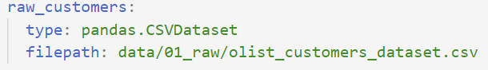
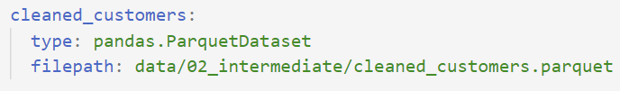
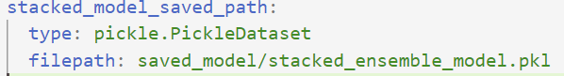
catalog.yml (JunMing)
Purpose: Tells Kedro where to save or load datasets.
Data is loaded from .csv files using Pandas for cleaning.
Cleaned datasets are saved as .parquet files, providing faster read/write speeds, smaller file sizes, and preserving data types for smooth processing.
Dataset are merged and feature engineering is applied to get final dataset.
The trained stacked ensemble model is stored as a .pkl file in the saved_model/ folder.

Slide 40
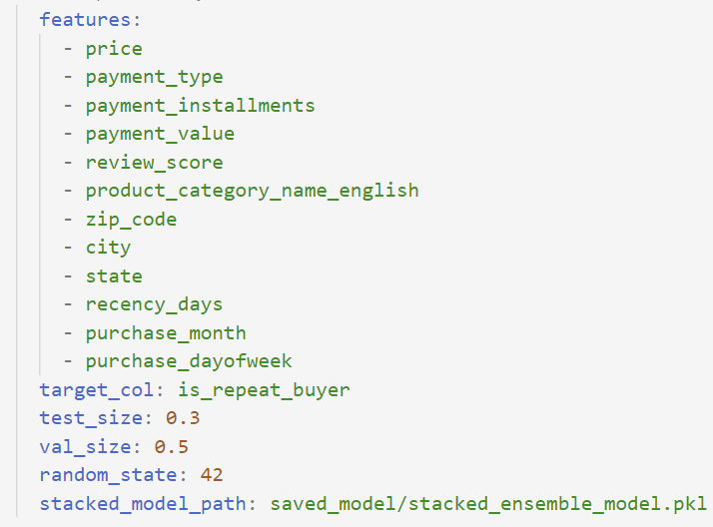
parameters.yml (JunMing)
Purpose: Listed all the parameters used for model training.
Indicated the features used for training.
Defined the target for model training.
Define seed value to ensure reproducibility.
Defines where the final stacked ensemble model will be saved on disk

Slide 41
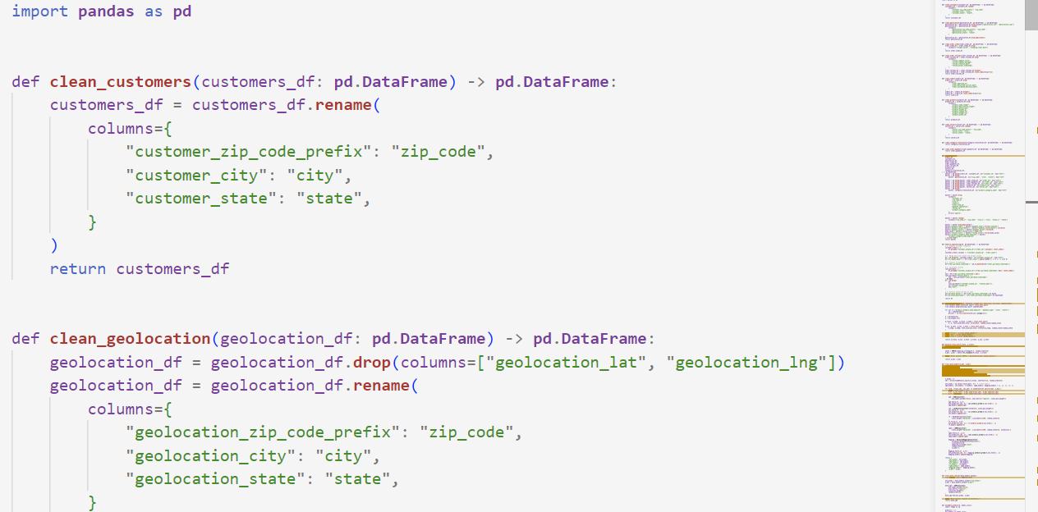
nodes.py (JunMing)
Purpose: Defines functions to perform tasks such as data cleaning, feature engineering, data splitting and balancing, training and evaluation within the Kedro pipeline.
Ensures reproducibility, reusability, and maintainability of the Kedro pipeline.
More details on the Nodes.py will be gone through the code walkthrough.

Slide 42
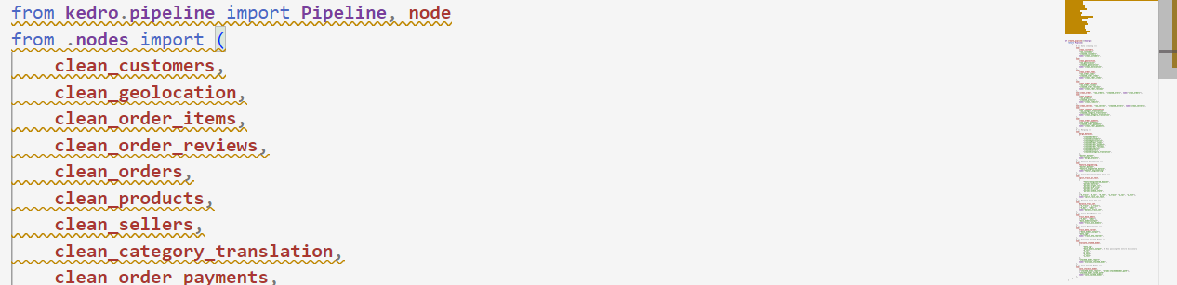
pipeline.py (JunMing)
Purpose: Defines and connects all the individual node functions in the Kedro pipeline, creating the full workflow from data cleaning to model saving.
Organizes the order of nodes in the pipeline.
Specifies inputs and outputs for each step.
Ensures a modular, reproducible, and easy-to-maintain workflow.
More details on the Nodes.py will be gone through the code walkthrough.

Slide 43
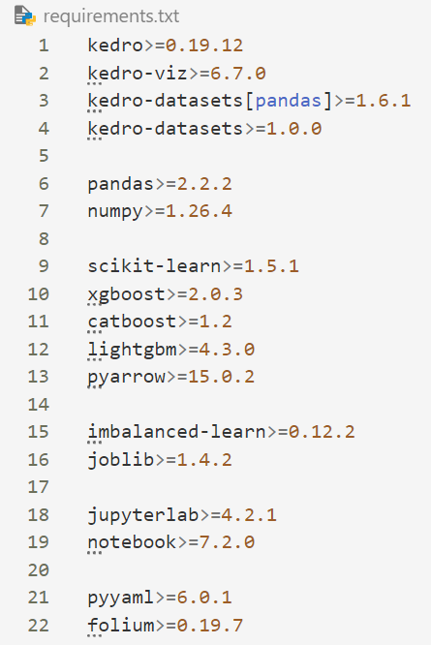
requirements.txt (JunMing)
Purpose: specifies all the external Python packages required for the project to run.

Slide 44
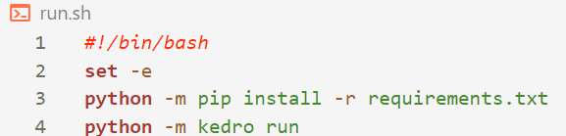
run.sh (JunMing)
Purpose: Automates the setup and execution of the Kedro pipeline.

Slide 45
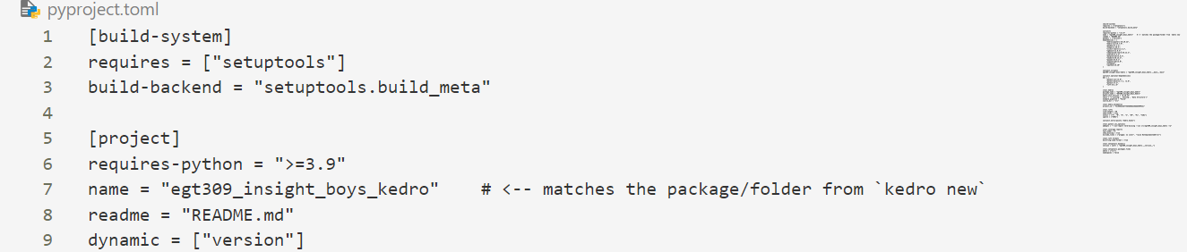
pyproject.toml (JunMing)
Purpose: Defines the overall build and packaging configuration for the Kedro project.

Slide 46
Why Use Docker
Reproducibility
Portability
Clean DevOps Practice
Anyone on the team can run the exact same pipeline code.
Works on any machine With Docker, be it MacOS, Windows or Linux, with just a single command.
It allows for production-ready development.

Slide 47
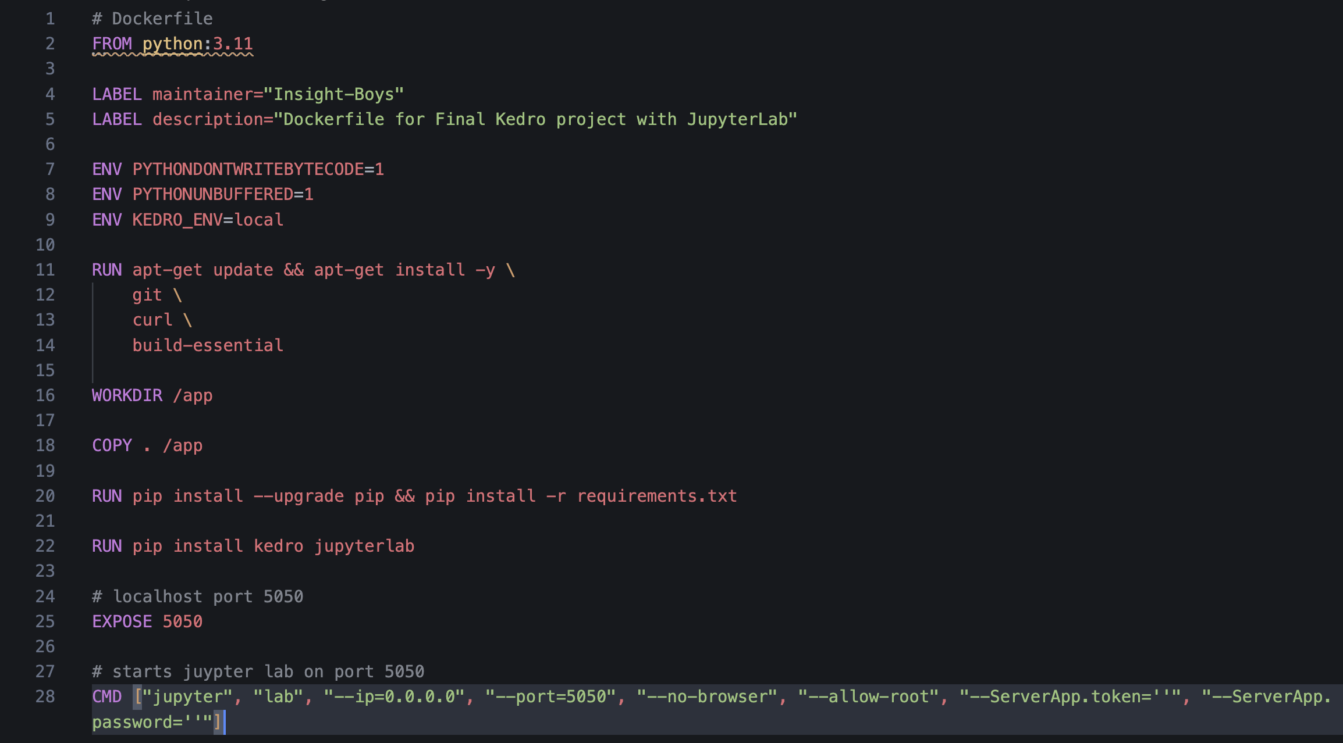
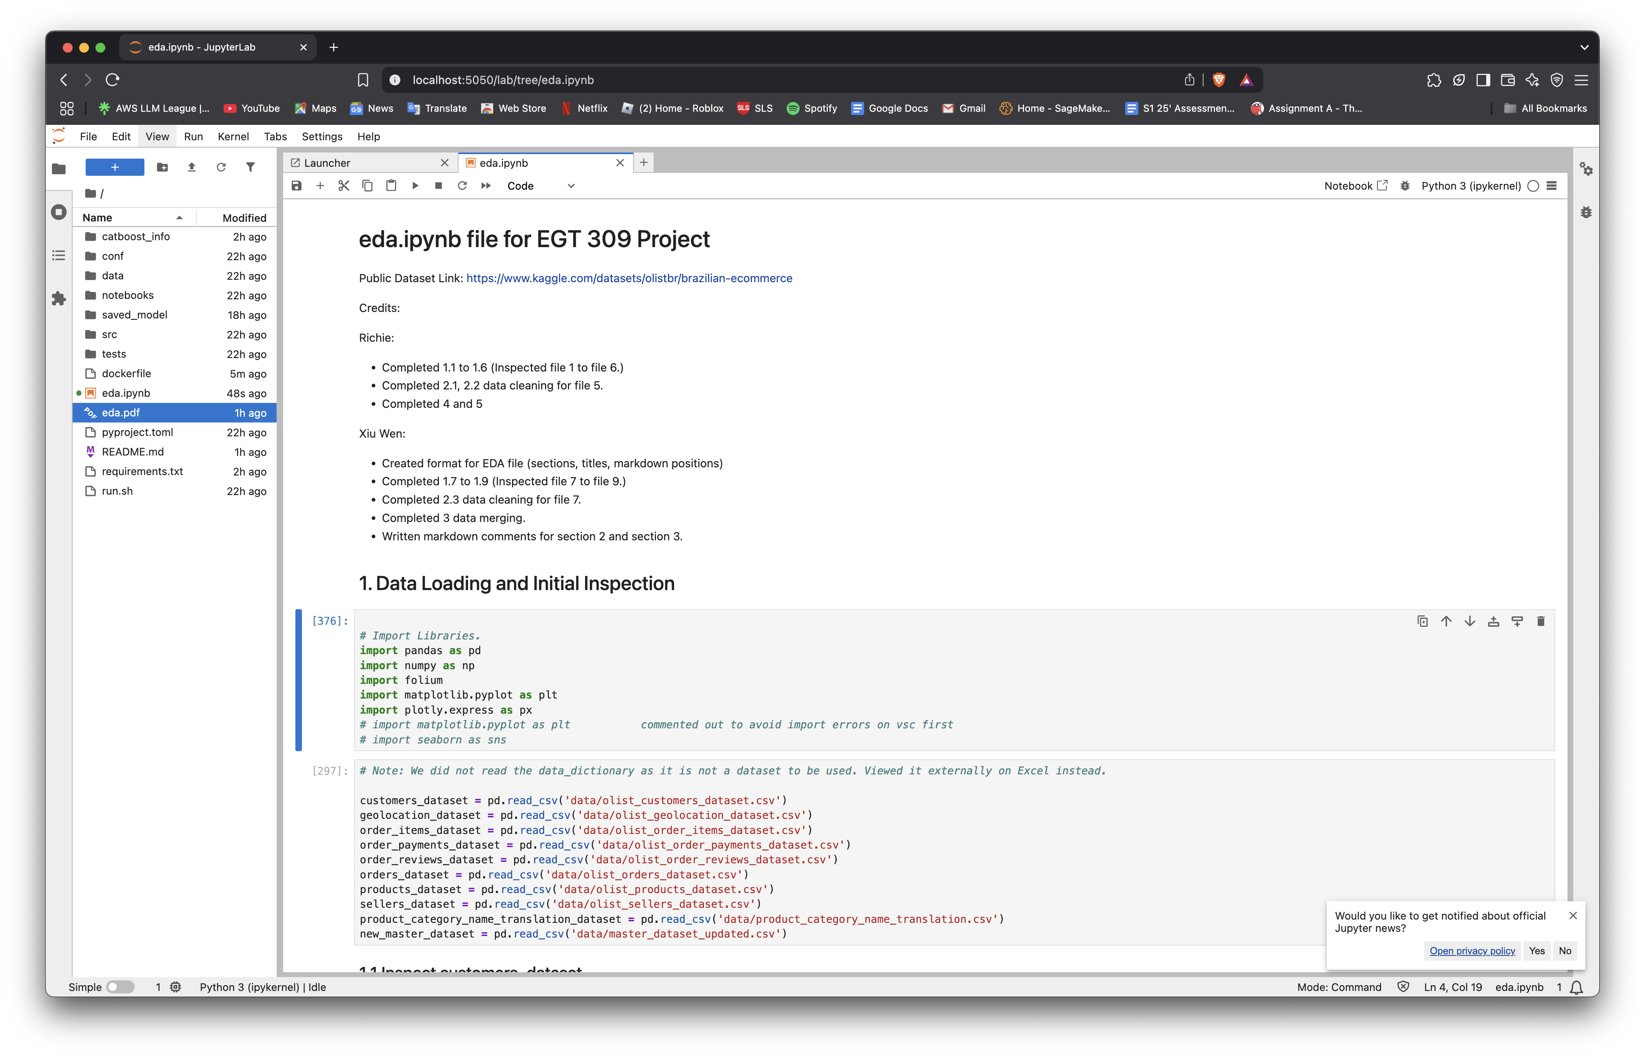
Docker(Sai)

Slide 48
Further Improvements
Instead of Model Learning, we can utilise Deep Learning Networks, which may handle class imbalance better than traditional Regression Machine Learning Models, and which may lead to better metrics as deep learning is more complex and is able to learn features better than Machine Learning Models.
We can create a UI such that it might allow for the companies to input the features, and the model is readily available to deliver results.
Add advanced feature engineering and model tuning
Automate data quality checks
As we dropped columns mainly to accommodate towards model training, we did not consider for visualizations. So, columns like ‘freight value’ could influence the rate of repeat buyers, but because we dropped them, we did not manage to gather some insights

Slide 49
Q&A
Please keep this slide for attribution

